Slide 1


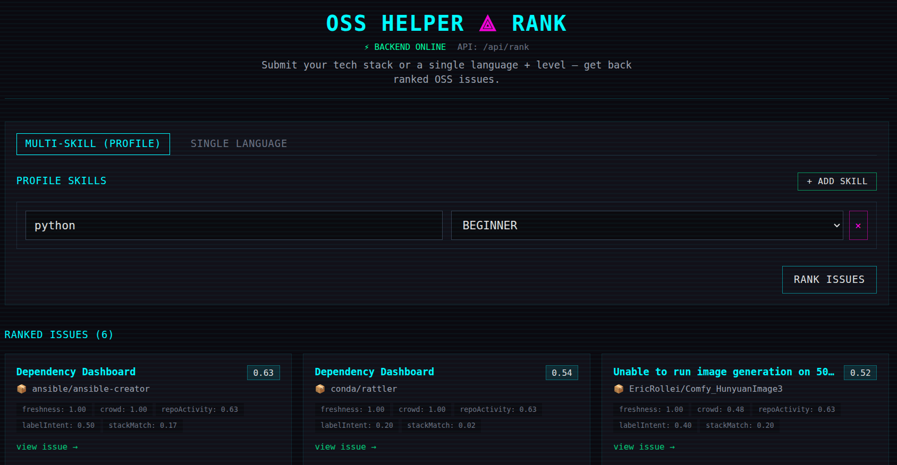


CHITKARA
>>
UNIVERSITY
OSIR
Open Source Issue Recommender
OPEN SOURCE
recommender.js
ISSUE RECOMMENDER
AN AI-ASSISTED RECOMMENDER FOR
LOW-CROWD, BEGINNER-FRIENDLY GITHUB ISSUES
BUILT FOR STUDENTS & JUNIOR DEVELOPERS
PRESENTED BY:
SHUBHAM SHARMA - 2210992369
SIDHARTH - 2210992378
SHUBHAM MITTAL - 2210992367
AI + signal-based scoring engine
SUPERVISED BY: DR. Swati
DEPARTMENT OF COMPUTER SCIENCE AND ENGINEERING,
CHITKARA UNIVERSITY, PUNJAB

Slide 2
CHITKARA
>>
UNIVERSITY
OSIR
PROBLEM
Open source contribution is hard to start.
Students and early-career developers
Comfortable with one or two stacks
Lack confidence in contributing to OSS
STATEMENT
"Good first issue" labels often:
Are overcrowded by other beginners
Are poorly scoped or under-described
Are already actively worked on
A CORE, UNIVERSAL ISSUE
Why new contributors stall before their first PR
Finding an approachable issue means:
Scanning dozens of repositories
Wasted hours on unsuitable threads
Discouragement and drop-off
Outcome: motivated learners abandon OSS before their first contribution.

Slide 3




CHITKARA
>>
UNIVERSITY
OSIR
OBJECTIVE (RAID)
OBJECTIVE OF THE PROJECT
Using modern web technologies
REDUCE
ANALYZE
Time spent searching
Issue clarity & difficulty
Cut the hours new contributors
spend filtering through GitHub
Use AI to read descriptions
and discussion threads
RANK
EXPLAIN
Issues by approachability
Why each issue is suggested
Combine freshness, comments,
labels, and tech stack signals
Surface the primary signals
that influenced the ranking

Slide 4





CHITKARA
>>
UNIVERSITY
OSIR
PROPOSED
What the system does
Analyzes issues across many repositories
SOLUTION
Reads descriptions and discussion threads
Filters by skill alignment with the user's stack
CORE VALUE PROPOSITION
Detects overcrowding from engagement signals
A backend service that curates, scores, and explains GitHub issues
Estimates difficulty with AI assistance
Returns each pick with transparent ranking signals
Resilient: AI-first, with a deterministic signal-based fallback
Transparent: every recommendation explains its top signals

Slide 5


CHITKARA
>>
UNIVERSITY
OSIR
SYSTEM
ARCHITECTURE
EVENT-DRIVEN, MERN-BASED PIPELINE
01
02
03
04
05
INPUT
FETCH
ANALYZE
SCORE
OUTPUT
User skills
+ tech stack
GitHub API
issue collector
AI assessment
(Meta Llama)
Signal-based
scoring engine
Ranked list
+ explanations
LAYER BREAKDOWN
FALLBACK MODE
Frontend: React (skills input, results UI, signal explainer)
Backend: Node.js + Express (orchestration, scoring, caching)
Data: MongoDB (cached issues), GitHub REST/GraphQL (live source)
AI: Meta Llama via API (clarity, difficulty, crowd estimation)
If AI services are unavailable, the system falls back to a deterministic signal-based scoring model.

Slide 6






CHITKARA
>>
UNIVERSITY
OSIR
TECHNOLOGY
FRONTEND
BACKEND
React.js
User input + results UI
Node.js + Express
API orchestration
STACK
DATABASE
DATA SOURCE
MERN + AI APIs
MongoDB
Cached issues + metadata
GitHub REST + GraphQL
Live issue feed
Open, modern, well-supported components
AI LAYER
RUNTIME
All components are open or commercially available; no proprietary lock-in.
Meta Llama via API
Clarity + difficulty
REST APIs, JSON
Event-driven jobs

Slide 7
CHITKARA
>>
UNIVERSITY
OSIR
AI-powered issue assessment
KEY
Reads descriptions + threads to estimate clarity and difficulty
Skill-stack matching
FEATURES
Prioritizes issues in repos that match the user's stack
Crowd-level filtering
Down-ranks issues with high comment counts to avoid overlap
CORE FUNCTIONAL CAPABILITIES
Issue freshness scoring
Prefers issues opened within the last 7 to 30 days
What the recommender actually does for the contributor
Repository activity check
Penalizes repos with 30 to 60+ days of inactivity
Transparent ranking explanations
Designed for contributors who want a curated short list, not another search.
Each pick lists the primary signals behind its score
Deterministic fallback mode
Signal-based scoring runs if AI services are unavailable

Slide 8
CHITKARA
>>
UNIVERSITY
OSIR
WORKING FLOW
(PROCESS)
END-TO-END RECOMMENDATION PIPELINE
1
2
3
4
5
6
Skills input
Issue fetch
Pre-filter
AI evaluation
Composite score
Ranked output
User submits stack + interests
GitHub API pulls candidate issues
Labels, freshness, repo activity
Llama scores clarity + difficulty
Combine AI + signal weights
Top picks with signal explanations
Composite signals: freshness, comment count, repo activity, beginner labels, stack match, complexity proxy.

Slide 9

CHITKARA
>>
UNIVERSITY
OSIR
A small, curated short list of issues
MEASURABLE IMPACT FOR LEARNERS
Instead of dozens of tabs, a handful of approachable picks
EXPECTED
Stack-relevant, low-crowd matches
OUTCOME
Filtered for the user's actual technologies and capacity
Transparent ranking signals
CURRENT STATUS
Each pick names the factors that drove its score
~80% built. The system can already recommend GitHub issues using AI evaluation.
Faster path to a first contribution
Qualitative goals; metrics to be measured during user testing.
Less searching, more building and learning

Slide 10





CHITKARA
>>
UNIVERSITY
OSIR
CONCLUSION &
KEY TAKEAWAYS
SCALABLE SOLUTION + FUTURE EXPANSION
WHAT WE BUILT
FUTURE SCOPE
An AI-assisted recommender that matches GitHub issues to a contributor's stack and capacity.
Combines AI evaluation with deterministic signal-based scoring, with a transparent explanation of why each issue is suggested.
Resilient by design: signal-based fallback runs when AI services are unavailable.
Browser extension for inline GitHub recommendations
Auto-detect skills from a contributor's GitHub profile
Mentor matching with active maintainers
Multi-platform support (GitLab, Bitbucket, Codeberg)
Contribution analytics and lightweight gamification

Slide 11
CHITKARA
>>
UNIVERSITY
THANK
YOU
OPEN SOURCE ISSUE RECOMMENDER
PRESENTED BY:
SHUBHAM SHARMA - 2210992369
SIDHARTH - 2210992378
SHUBHAM MITTAL - 2210992367

